Slide 1

PROBLEM?

Slide 2


Slide 3


Slide 4
WHAT IS POOL?
SOCIAL PLATFORM
1
DEDICATED FOR HOSTELERS
2
PEER TO PEER INTERACTION
3
E FORM OF SOCIETIES

Slide 5


STRENGTHS
DIRECT INTERACTION WITH GROUP OF SAME INTEREST.
COME,JOIN AND PROGRESS.
COLLEGE LEVEL PROGRESS.
NO MORE TIME WASTING.
(SOCIAL MEDIA)

Slide 6
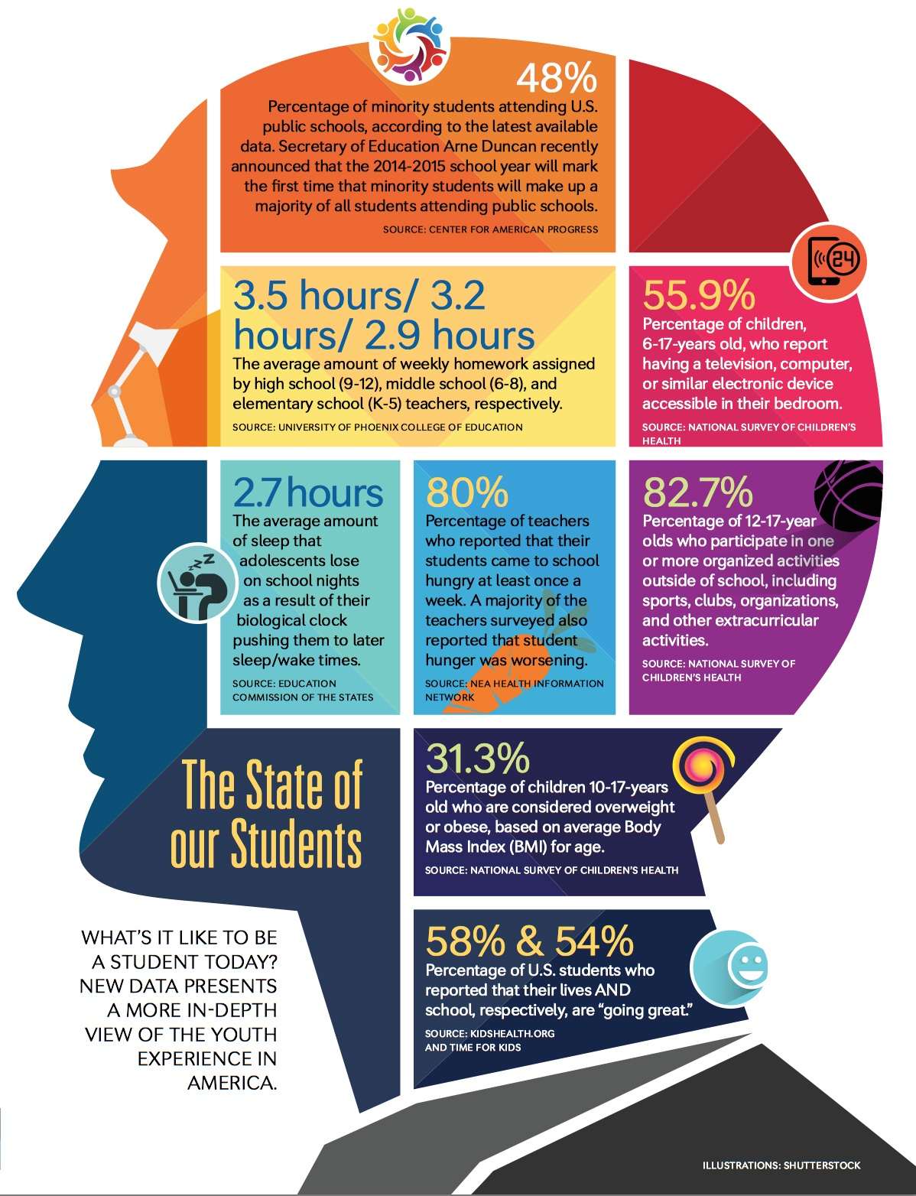
WEAKNESS
Can be assumed as normal Social networking sites.
Improper awareness about platform.
Still in progress.

Slide 7

OPPORTUNITY
Can be extended among faculty members after trial.
Interaction with GURUs currently working in that field.
Organising Events in collaboration.
One APP policy.

Slide 8

THREAT
LEAKAGE OF PERSONAL DETAILS.
(STRONG SECURITY MEASURES)

Slide 9

THANK YOU

